Slide 1


Adolescent Substance Use
Kit Bayer, MSW, LICSW
Clinical Social Worker
Boston Children’s Hospital
Division of Addiction Medicine- Primary Care Plus

Slide 2
CIT Youth Training Objectives
Understand how adolescent brain development creates special vulnerability to developing substance use disorders
Develop an understanding of the neurobiology of substance use in the context of nicotine, cannabis, and alcohol
Learn the impact of adolescent substance use on physical and mental health
Notes:
Focus on cannabis, nicotine, and alcohol
Will start by sharing some statistics of adolescent substance use

Slide 3
Terminology
INSTEAD OF… | TRY PERSON-FIRST LANGUAGE
Drug Abuse | Substance use disorder, addiction
Abuser, addict, junkie, alcoholic | Person with a substance use disorder
Clean | Abstinent, not using Negative test
Dirty | Actively using Positive test
Addicted baby | Baby with Neonatal Abstinence (or Opioid Withdrawal) Syndrome
Medication-Assisted Treatment | Medication or treatment for (substance) use disorder

Slide 4
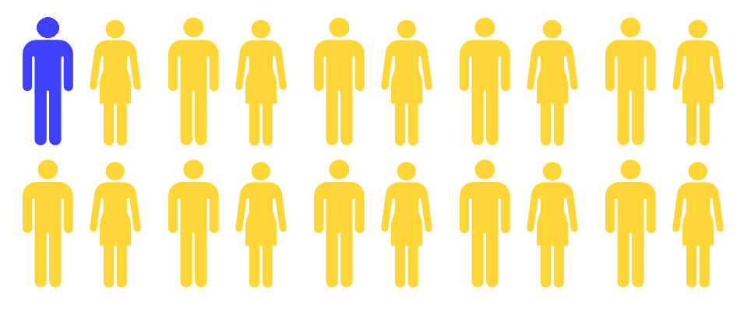
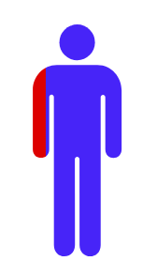

Adolescent Substance Use and Treatment
4.5% of adolescents ages 12-17
diagnosed with a past year SUD
Only 8.3% of them
received treatment
Source: Substance Abuse and Mental Health Services Administration. (2020). Key substance use and mental health indicators in the United States: Results from the 2019 National Survey on Drug Use and Health (HHS Publication No. PEP20-07-01-001, NSDUH Series H-55). Rockville, MD: Center for Behavioral Health Statistics and Quality, Substance Abuse and Mental Health Services Administration. Retrieved from https://www.samhsa.gov/data/
Notes:
During 2019 in the U.S:
4.5% of adolescents ages 12-17 were diagnosed with a past year SUD
8.3% of adolescents ages 12-17 were diagnosed with a past year SUD received treatment
0.7% of (all) adolescents ages 12-17 received any SUD treatment

Slide 5
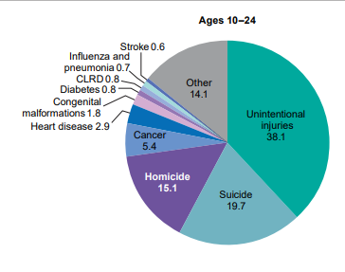
Leading Causes of Mortality among Persons
Ages 10-24 Years, United States, 2019
Heron M. Deaths: Leading causes for 2019. National Vital Statistics Reports; vol 70 no 9. Hyattsville, MD: National Center for Health Statistics. 2021.
Notes:
Adolescent substance use increases the risk of death in three leading causes of mortality among adolescents.

Slide 6
Substances Used by 12th Graders, 2021
Substance | Lifetime (%) | Past 30 Days (%)
Alcohol | 54.1 | 25.8
Nicotine (Vaping) | 38.7 | 19.6
Any illicit drug | 41.3 | 20.6
Marijuana | 38.6 | 19.5
Marijuana (Vaping) | 25.7 | 12.4
Inhalants | 5.0 | 0.7
Hallucinogens | 7.1 | 1.0
Cocaine | 2.5 | 0.3
Amphetamines | 4.9 | 1.0
Heroin | 0.4 | 0.1
Narcotics other than Heroin | 2.3 | 0.3
While experimentation with alcohol is common, less than half of 12th graders are current (past 30 days) drinkers. Some kids and adults think that “all” high schoolers use marijuana, but the truth is that less than half (38.6%) of seniors have ever tried it and only 12.4% use currently.
NIDA. 2021, Monitoring the Future Study: Trends in Prevalence of Various Drugs | National Institute on Drug Abuse (NIDA)

Slide 7
Most drug use starts in adolescence
16-17
18-20
14-15
21-25
12-13
26 and Older
Notes:
Adolescents are developmentally vulnerable to developing substance use disorders and problems associated with substance use
90-95% substance use starts in adolescence

Slide 8
Age at first use and later risk
Alcohol
% with Marijuana Disorder
Marijuana
% with Alcohol Disorder
Age at First Drink
Age at First Use
Source: Hingson RW, Heeren T, Winter MR. Age at drinking onset and alcohol dependence. Arch Pediatr Adolesc Med. 2006;160:739-746.
Notes:
In addition to the intense reward seeking behavior that adolescents have, research has also shown that age at first use of alcohol and marijuana is strongly connected to the risk of developing a substance use disorder later in life.
These graphs show that as the age at first drink increases, the proportion of those who develop a substance use disorder decreases. For example, this study found that nearly half of those who had their first drink at age 13 or younger developed an alcohol use disorder during their lifetime, but less than 10% of those who had their first drink at age 21 or older did. Similarly, almost 1 in 5 youth who first used marijuana at age 13 or younger went on to develop a marijuana use disorder during their lifetime, whereas less than 5% of those who did not use until at least age 21.
This highlights that delaying use, even by a few years, greatly reduces the chances that someone will develop a substance use disorder.

Slide 9
Substance Use Disorder
DSM 5 Criteria for Substance Use
Definition: A problematic pattern of substance use leading to clinically significant impairment or distress, as manifested by at least two of the following, occurring within a 12-month period:
The substance is often taken in larger amounts or over a longer period than was intended.
There is a persistent desire or unsuccessful efforts to cut down or control substance use.
A great deal of time is spent in activities necessary to obtain the substance, use the substance, or recover from its effects.
Craving, or a strong desire or urge to use the substance.
Recurrent substance use resulting in a failure to fulfill major role obligations at work, school, or home.
Continued substance use despite having persistent or recurring social or interpersonal problems caused or exacerbated by the effects of the substance
Important social, occupational, or recreational activities are given up or reduced because of substance use
Recurrent substance use in situations in which it is physically hazardous
Substance use is continued despite knowledge of having a persistent or recurrent physical or psychological problem that is likely to have been caused or exacerbated by the substance10. Tolerance, as defined by either of the following: A. A need for markedly increased amounts of the substance to achieve intoxication or desired effect B. Markedly diminished effect with continued use of the same amount of the substance.
11. Withdrawal, as manifested by either of the following: A. The characteristic withdrawal syndrome for the substance B. Substance (or a closely related substance) is taken to relieve or avoid withdrawal symptoms.
*Tolerance and withdrawal do not apply when using appropriately under medical supervision

Slide 10
Addiction as a Chronic Disease
A disorder of structure or function that produces specific signs or symptoms
Addiction has defined causes (genetics, social, environment) and observable consequences (behavioral, biological)
Comparison to chronic conditions like depression, type 2 diabetes, hypertension, and asthma
  May be caused in part by genetic factors
  Environmental factors influence development and course of illness
  Contributions of voluntary behavior
  Difficult to manage behaviorally
  Similar treatment adherence and relapse rates
  Responds to ongoing treatment
  Some will have to engage in lifelong management of the condition

Slide 11
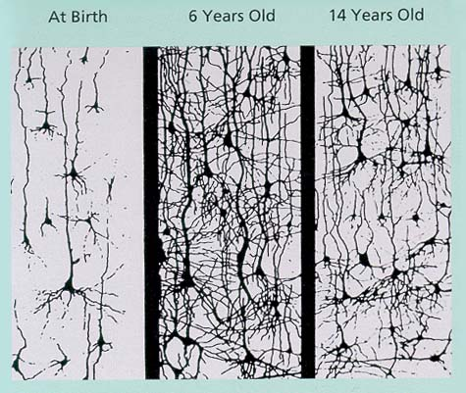
Neuron Growth & Development
© Boston Children’s Hospital, 2020. All Rights Reserved.
Image retrieved from: http://etec.ctlt.ubc.ca/510wiki/Brain-based_Learning
Notes:
The synaptic density picture on left of this slide shows the development of synapses in the brain. Synapses are the connections that form as we learn to do things.
At birth, the immature brain has very few synapses formed. The brain is like a blank canvas and is ready for a lot of learning.
By the age of six, we have learned a lot. As the brain matures, it enters into a period called blossoming.
During blossoming, there is a ton of brain activity. Connections are formed as the brain learns new things and the brain is full of synapses as we go through a period of intense learning.
As we get older, the brain figures out which connections it really needs and starts a process called pruning.
During pruning, neuronal connections that are not used will get pruned away to make those connections that are there more efficient. (e.g. this is why it is easier to learn a language at age 5 than age 15.
The connections that stay go through a process called myelination in which a myelin sheath forms around the pathways to allow them to work more efficiently.
A process I want you to remember in the context of SU

Slide 12
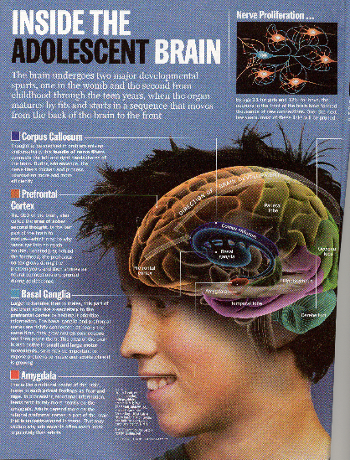
What we now know
Adolescence is a critical period in brain development
The brain is still developing until approximately age 24 or 25
Slide courtesy of Ken Winters, PhD.

Slide 13
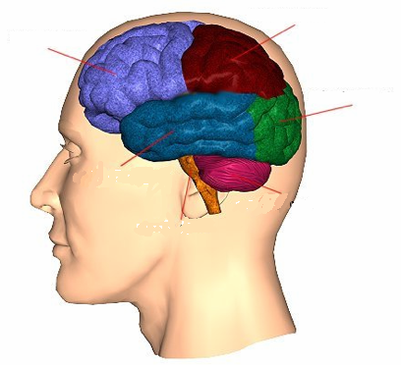
How the brain develops
Front
Back
Frontal Lobe
Parietal Lobe
Prefrontal Cortex
Occipital Lobe
Hippocampus
Amygdala
Nucleus Accumbens
Temporal
Lobe
Cerebellum
Brain Stem
Notes:
The large reason for the differences between adolescence and adults is brain development. What used to be believed is that brain development is completed by age 10, when a person’s brain generally reaches the same size as it will be as an adult. But now, thanks to developments that gave us MRI and fMRI technology, we know that brain cells (neurons) are continuing to grow, connect, and strengthen until a person is approximately 24 or 25.
And what we also now know is that the brain develops in different areas at different times. A gross simplification is that the brain develops from back to front, meaning that the frontal lobe is the last to fully develop. An area of the brain that is undergoing substantial development during adolescence is here in the temporal lobe, where emotions, memory, and pleasure are all processed. This is the part of the brain that says, “Go, try, seek pleasure, and re-seek whatever has given you pleasure previously.” While the frontal lobe, not yet developed, is where we apply logic, plan, control our impulses, and think about future implications.
In the analogy of a car, the temporal lobe is like a gas pedal while the frontal lobe is the brake. Thus, adolescents are all acceleration with no brakes.
What all this means is that substance use in adolescence looks different and has different implications.
Adolescents are not “little adults”
Use alcohol differently
Different long term risks
More use of other psycho-active substances
Validity of screening tools varies
Issues of confidentiality
The way brain development generally happens is from back to front, which is somewhat of an oversimplification. This development track makes sense when you think about the functions of areas such as the brain stem and cerebellum, which keep us alive and help us function in the world on a very basic level. (with the cerebellum developing more rapidly early on, and the frontal lobe reaching full maturity last.)
, the Hippocampus, the Amygdala, the Nucleus Accumbens and the Prefrontal Cortex are all very important areas that develop later, starting in adolescence. They also are directly impacted by substance use and play a role in the potential development of a substance use disorder, which I will explain more briefly.
The amygdala and the hippocampus are both part of the limibic system, which is the system that is responsible for our emotional memory, our response to fear (fight or flight) and our pleasure response.
The amygdala is important for making associations across stimulus modalities (a certain fragrance often elicits an associated visual image).
The Hippocampus is very important in the transition of information from short to long term memory, Since the Hippocampus is also part of the Temporal Lobe, damage to that portion of the brain can result in a loss of memory.
Then there is the nucleus accumbens is the pleasure center of our brain, which is where we are reminded what makes us feel good and reminds us to go after those things.
Brain stem: basic vital life functions such as breathing, heartbeat, and blood pressure.
Cerebellum: Regulation and coordination of movement, posture, and balance, as well as Sensory processing.
Nucleus accumbens: motivation
Lymbic System:
Amygdala: involved in memory, emotional processing
Hippocampus: for learning and memory . . . for converting short term memory to more permanent memory, and for recalling spatial relationships in the world about us
Prefrontal cortex: Planning, Organizing, Impulse control
The temporal lobe, which includes the amygdala and the nucleus accumbens, develops rapidly during middle childhood and adolescence. The nucleus accumbens is part of the reward system and controls our desire to engage in activities that give us pleasure (e.g. why rewards via positive reinforcement, earning good grades etc. are effective in elementary and middle school).
The amygdala is located within the temporal lobe and is responsible for our emotions and registering whether something feels pleasurable or painful (e.g. the “terrible twos” and temper tantrums of the preschool years demonstrate the beginning of its development).

Slide 14
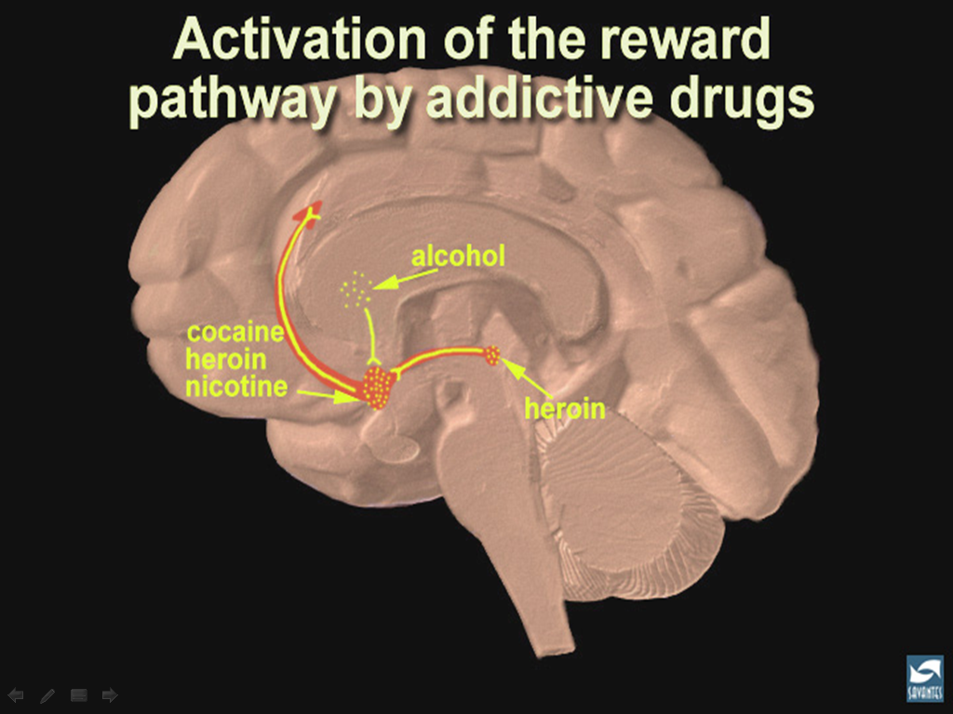
marijuana
Image retrieved on February 17, 2015, from http://www.drugabuse.gov/publications/teaching-packets/neurobiology-drug-addiction/section-iv-action-cocaine/7-summary-addictive-drugs-activate-reward
Notes:
Yellow dots indicate where different addiction substances have effects on neurotransmission, which vary but which all cause the NA to have a flood of dopamine, which then acts on NA neuron output to other parts of brain.
When we use substances, they activate the reward pathways in the brain.
In this image, yellow dots indicate where different addictive substances affect neurotransmission.
While substances affect different locations and have different activation mechanisms (e.g. alcohol activates the globus pallidus, which connects to the reward pathway), they all increase reward pathway activity by flooding the nucleus accumbens with dopamine (e.g. cocaine binds to dopamine transporters that normally return dopamine to the neuron that released it, thus blocking the removal of dopamine from synapses leading to a buildup (flood) of dopamine).
The flood of dopamine then acts on the nucleus accumbens’ neurotransmission to other parts of brain.

Slide 15
Brain Maturation
Limbic System
(mature in adolescence) Includes hippocampus and amygdala
  Emotional memory
  Fear response
  Pleasure response
  Fight or Flight
Nucleus Accumbens
(highly active in adolescence)
  Pleasure center
  Active during pleasurable activities, including feeding, sex and drug use
  Plays a major role in addiction
Prefrontal Cortex
(mature in late adolescence/early adulthood)
  Impulse control
  Decision-making
  Organizing and planning
  Abstract thought, rational thinking
  Attention, focus
  Working memory

Slide 16

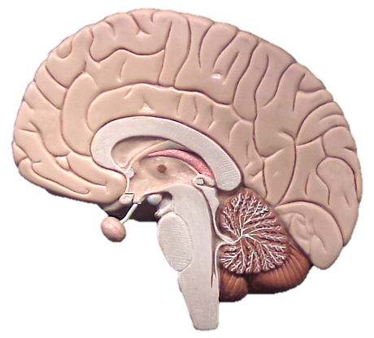
Cerebellum
Notes:
Cerebellum: Regulation and coordination of movement, posture, and balance, as well as Sensory processing.

Slide 17

Amygdala
Notes:
The amygdala is located within the temporal lobe and is responsible for our emotions and registering whether something feels pleasurable or painful (e.g. the “terrible twos” and temper tantrums of the preschool years demonstrate the beginning of its development).
The amygdala and the hippocampus are both part of the limibic system, which is the system that is responsible for our emotional memory, our response to fear (fight or flight) and our pleasure response.
The amygdala is important for making associations across stimulus modalities (a certain fragrance often elicits an associated visual image).

Slide 18

A+
Nucleus accumbens
Notes:
The temporal lobe, which includes the amygdala and the nucleus accumbens, develops rapidly during middle childhood and adolescence. The nucleus accumbens is part of the reward system and controls our desire to engage in activities that give us pleasure (e.g. why rewards via positive reinforcement, earning good grades etc. are effective in elementary and middle school).

Slide 19

Prefrontal cortex

Slide 20
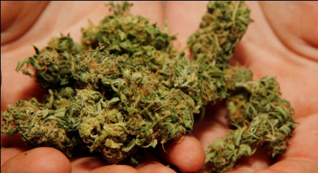
Cannabis

Slide 21
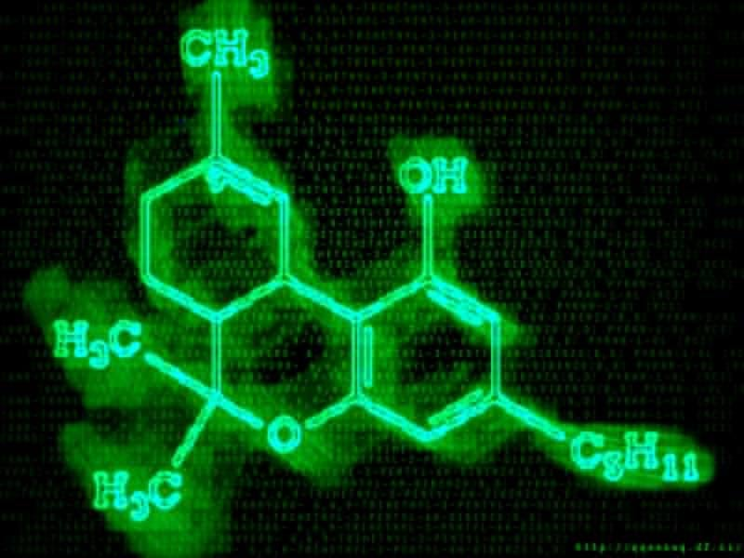
What is in Cannabis?
Contains many cannabinoid chemicals …
  Delta-9-tetrahydrocannabinol (THC)
  delta-8-tetrahydrocannabinol
  cannabidiol
  cannabinol
  cannabichromene
  cannabigerol
  Etc.
Source: Mechoulam R, Hanus L, The cannabinoid system from the point of view of a chemist. In Marijuana and Madness. ed. Castle, Murray. Cambridge University Press, 2004

Slide 22
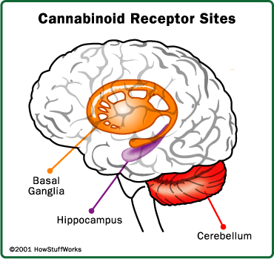
The Brain and Cannabis
22
Notes:
22

Slide 23
Endocannabinoid System: Regulation
The neuron’s “volume control”: dials down neuron activity when too strong
Regulates levels of important neurotransmitters affecting pleasure, mood, pain, appetite, sleep, motivation, focus, memory, attention etc. (dopamine, serotonin, endorphins)
Helps keep neuron activity in balance, not underactive or overactive

Slide 24
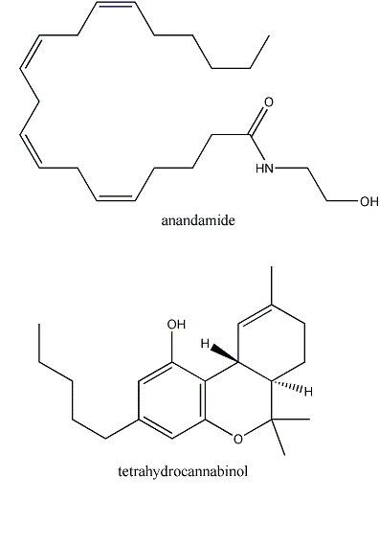
Cannabinoid Receptors
Your body produces its own cannabinoid chemical called Anandamide which binds to cannabinoid receptors in your brain

Slide 25
Cannabinoid receptors in our brains? Why?
Animal studies show that without Anandamide…
  Experience more pain
  Can’t control appetite
  More anxious
  Less able to cope with stress

Slide 26
THC vs. Anandamide
Both dial down neuron activity to change neurotransmitter release
THC has a MUCH STRONGER, LONGER effect than anandamide on brain cells
THC interferes with anandamide function, so it can’t do its job to protect and balance cell activity

Slide 27
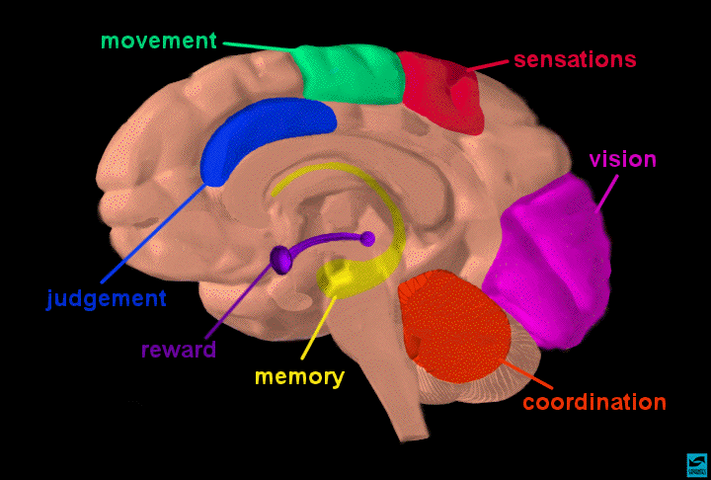
What’s affected by cannabis?

Slide 28
Pleasurable Affects
Mild Euphoria
Visual and Auditory Enhancements
Increased Talking
Adverse Affects
Decreased Coordination and Reaction Time
Impaired Ability to
Concentrate
Impaired Memory and Learning

Slide 29
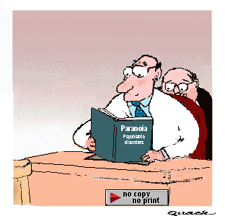
Overuse/Toxicity
Mood fluctuations
Hallucinations
Depersonalization
Anxiety and panic
Paranoia
Vomiting

Slide 30
Cannabis Withdrawal Symptoms
Restlessness, anxiety
Increased irritability, anger, aggression
Difficulty falling and staying asleep, nightmares/strange dreams
Decreased appetite
Weight loss
Source: Budney et al. Arch Gen Psych 58(10):917-924, 2001.

Slide 31
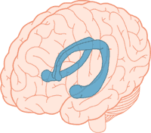
THC reduces hippocampal neuron activation
With chronic THC exposure, neurons are gradually lost due to continual suppression
  Those that use THC have smaller hippocampuses, and poorer memory
Source: Iversen L. How cannabis works in the brain. In Marijuana and Madness. Ed. Castle & Murray, 2004. Oxford University Press.
Notes:
One well known effect of marijuana use is memory impairment. Scientists have found that THC dampens down the activity of hippocampal neurons, below the level needed to trigger the formation of a memory.
With chronic THC exposure, and therefore, continual suppression of hippocampal neuron activity, the neurons start to lose connections to other neurons, making it harder to form and retrieve memories.
Brain imaging studies have found that regular marijuana users actually have, on average, smaller hippocampuses than non-users, and poorer memory performance. While we all tend to lose neurons in the hippocampus as we age (which explains why we have a harder time remembering and learning things as we get older), chronic THC exposure will speed up this process. Scientists found that young rats exposed daily to THC for 8 months showed the same level of hippocampal cell loss as unexposed rats twice their age (Source: Marijuana Abuse, NIDA Research Report Series, 2010).
Developing temporal lobes include the developing hippocampus, which is a part of the brain responsible for memory and learning.
One part of the brain that has been found in research studies to be especially sensitive to the effects of alcohol is the hippocampus, which is here outlined in blue in the temporal lobe. This part of the brain plays a major role in learning and forming memories. It also helps to regulate sleep. The hippocampus typically grows during childhood and adolescence.

Slide 32
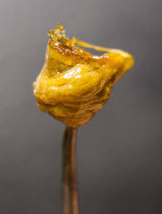
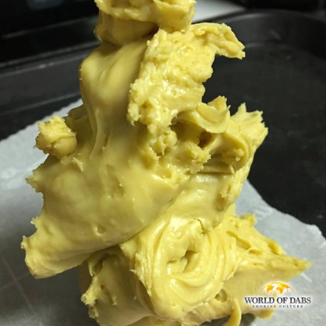


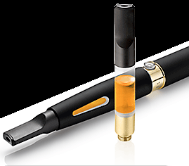
Forms of Butane Hash Oil
Contain up to 90% THC!
“Shatter”
“Dabs”
“Budder”
“Earwax”
“Vaping”
© Boston Children’s Hospital, 2020. All Rights Reserved.
Notes:
While a typical marijuana joint has 15 percent THC, reports suggest that hash oils can have THC concentration levels as high as 60-90 percent.
The higher dose is also more likely to cause users to develop tolerance, quickly requiring a larger dose to get the same effects. For many dab users, smoking herbal cannabis will no longer produce the desired effect.
As THC content of marijuana increases, so does its potential to cause adverse effects such as paranoia, anxiety and panic attacks, hallucinations, erratic mood swings and aggressive behavior. As you can see in the graph to the right, the number of young people showing up in the emergency department for marijuana-related reasons has risen sharply in recent years. In 2009, over 376,000 emergency room visits nationwide were caused by marijuana use (The DAWN Report, Substance Abuse and Mental Health Services Administration, 12/2010).

Slide 33
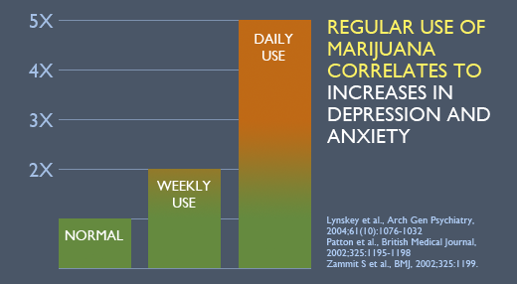
Thank You
Taken from www.teen-safe.org – with express permission from Dr. John Knight, Center for Adolescent Research CeASAR – Boston Children’s Hospital
© Boston Children’s Hospital, 2020. All Rights Reserved.
Notes:
5x greater risk of depression and anxiety with daily MJ use, and 2x greater risk with weekly use.
People who smoked marijuana in their teen years have a much higher risk of developing a mental illness than those who starting smoking as adults.
Marijuana doubles the risk of depression and anxiety disorders.
Daily marijuana users are five times as likely to develop a mood or anxiety disorder later in life.

Slide 34
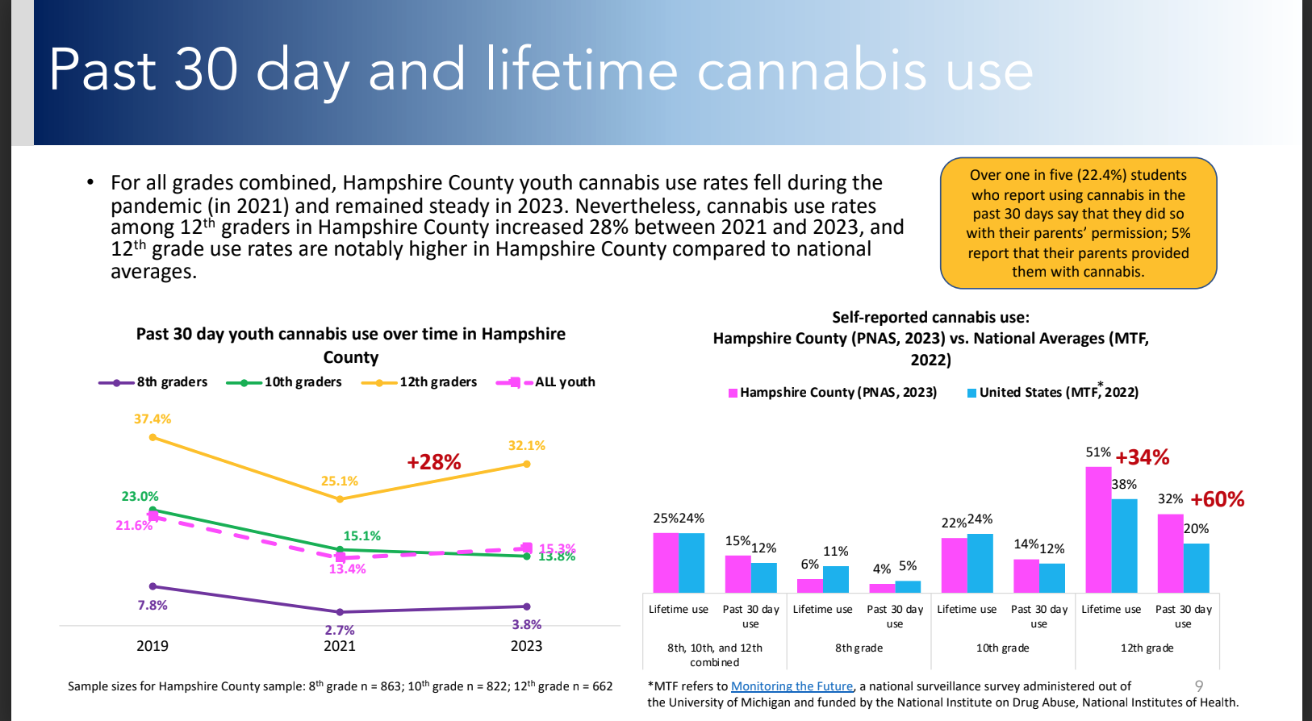

Slide 35
Long-term effects associated with cannabis use in adolescence
Psychosis¹
Depression^{2,3,4}
Anxiety⁴
Diminished life satisfaction and achievement^{5,6,7}
Cognitive decline^{8,9}
Addiction^{10,11}
Sources: 1. Griffith-Lendering, et al. (2013). 2. Manrique-Garcia, et al. (2012). 3. Fairman BJ & Anthony JC (2012). 4. Patton GC ,et al. (2002). 5. Fergusson DM, Horwood LJ, & Swain-Campbell N (2000). 6. Fergusson DM & Boden JM (2008). 7. Brook JS, et al. (2013). 8. Meier MH, et al. (2012). 9. Zalesky A, et al. (2012). 10. Lopez-Quintero C, et al. (2011). 11. Hall W & Degenhardt L (2009).
Notes:
Full citations:
Griffith-Lendering, M. F., Wigman, J. T., Prince van Leeuwen, A., Huijbregts, S. C., Huizink, A. C., Ormel, J.ollebergh, W. A. (2013). Cannabis use and vulnerability for psychosis in early adolescence-a TRAILS study. Addiction, 108(4), 733-740.
Manrique-Garcia, E., Zammit, S., Dalman, C., Hemmingsson, T., & Allebeck, P. (2012). Cannabis use and depression: a longitudinal study of a national cohort of Swedish conscripts. [Research Support, Non-U.S. Gov't]. BMC Psychiatry, 12, 112. 3.
Fairman, B. J., & Anthony, J. C. (2012). Are early-onset cannabis smokers at an increased risk of depression spells? J Affect Disord, 138(1-2), 54-62.
Patton GC, Coffey C, Carlin JB, Degenhardt L, Lynskey M, Hall W. Cannabis use and mental health in young people: cohort study. BMJ 2002;325:1195-1198
Fergusson, D. M., Horwood, L. J., & Swain-Campbell, N. (2002). J. The relationship between marijuana initiation and dropping out of high school. Health Econ 2000;9:9-18
Fergusson DM, Boden JM. Cannabis use and later life outcomes. Addiction 2008;103:969-976
Brook JS, Lee JY, Finch SJ, Seltzer N, Brook DW. Adult work commitment, financial stability, and social environment as related to trajectories of marijuana use beginning in adolescence. Subst Abus 2013;34:298-305
Meier MH, Caspi A, Ambler A, et al. Persistent cannabis users show neuropsychological decline from childhood to midlife. Proc Natl Acad Sci U S A 2012;109:E2657-E2564
Zalesky A, Solowij N, Yucel M, et al. Effect of long-term cannabis use on axonal fibre connectivity. Brain 2012;135:2245-2255
Lopez-Quintero C, Perez de los Cobos J, Hasin DS, et al. Probability and predictors of transition from first use to dependence on nicotine, alcohol, cannabis, and cocaine: results of the National Epidemiologic Survey on Alcohol and Related Conditions (NESARC). Drug Alcohol Depend 2011;115:120-130. 8.
Hall W, Degenhardt L. Adverse health effects of non-medical cannabis use. Lancet 2009;374:1383-1391 9.

Slide 36
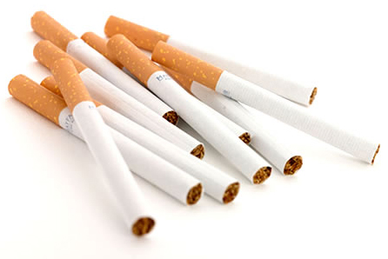
Nicotine
Notes:
We’re now going to talk about nicotine. Despite years of decline in tobacco and nicotine use in adolescent populations, the past few years have shown an increase in rates of use among adolescents, largely due to vaping mechanisms.

Slide 37
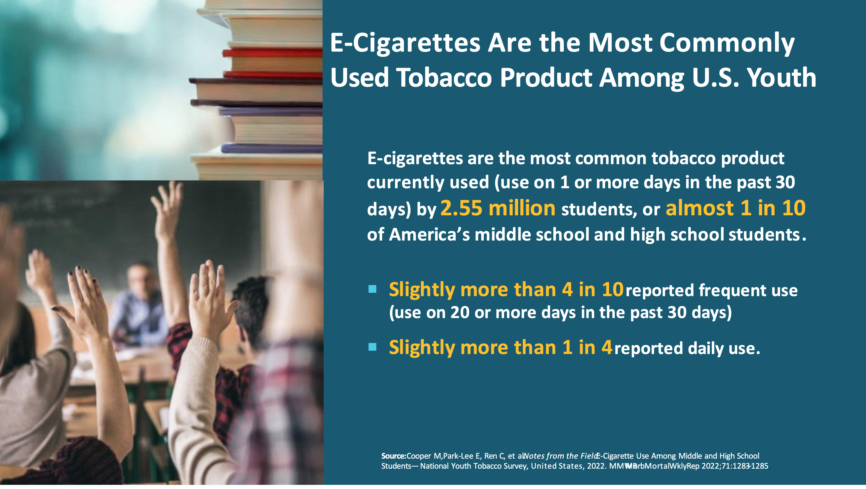

Slide 38
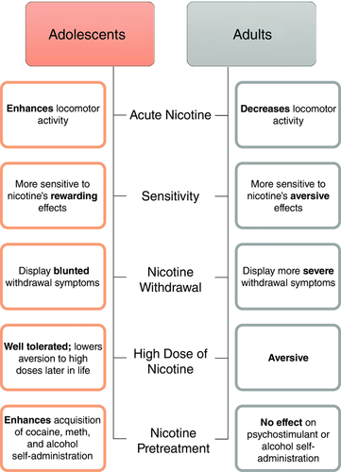
Differences in Effect
© Boston Children’s Hospital, 2020. All Rights Reserved.
Source: https://physoc.onlinelibrary.wiley.com/doi/full/10.1113/JP270492
Notes:
One of the reasons that nicotine is so dangerous for adolescents is that it impacts the adolescent brain very differently than the adult brain. While adults may experience the negative effects of nicotine, especially in high doses, adolescents experience more rewarding effects. Their locomotor activity increases, they have less withdrawal symptoms when they don’t use, and they tolerate high doses very well. All of this contributes to developing nicotine use disorders very quickly, especially when exposed to high doses of nicotine.
Due to the high doses of nicotine that vaping devices can administer in short periods of time, many people who vape experience nicotine toxicity. Symptoms include stomach pain, dizziness, headaches and decreased concentration.

Slide 39
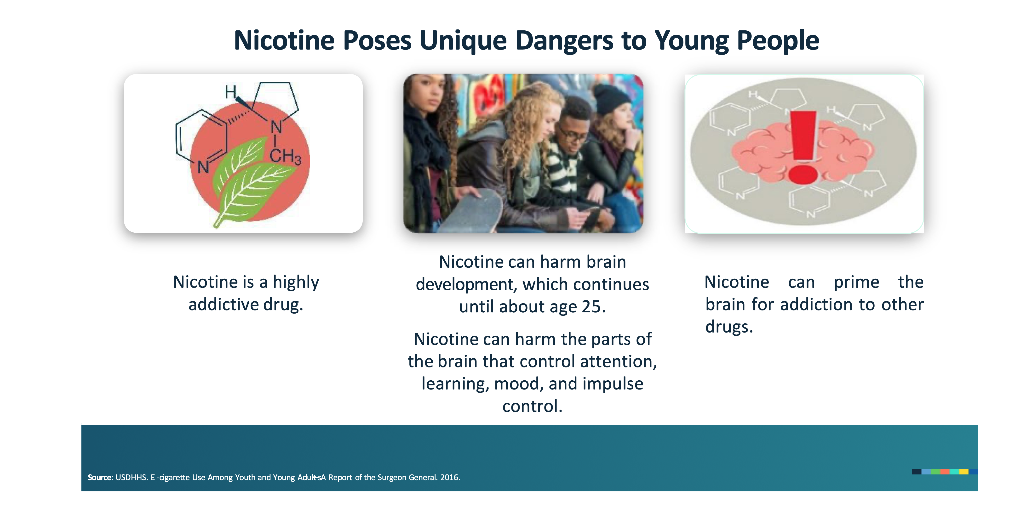

Slide 40
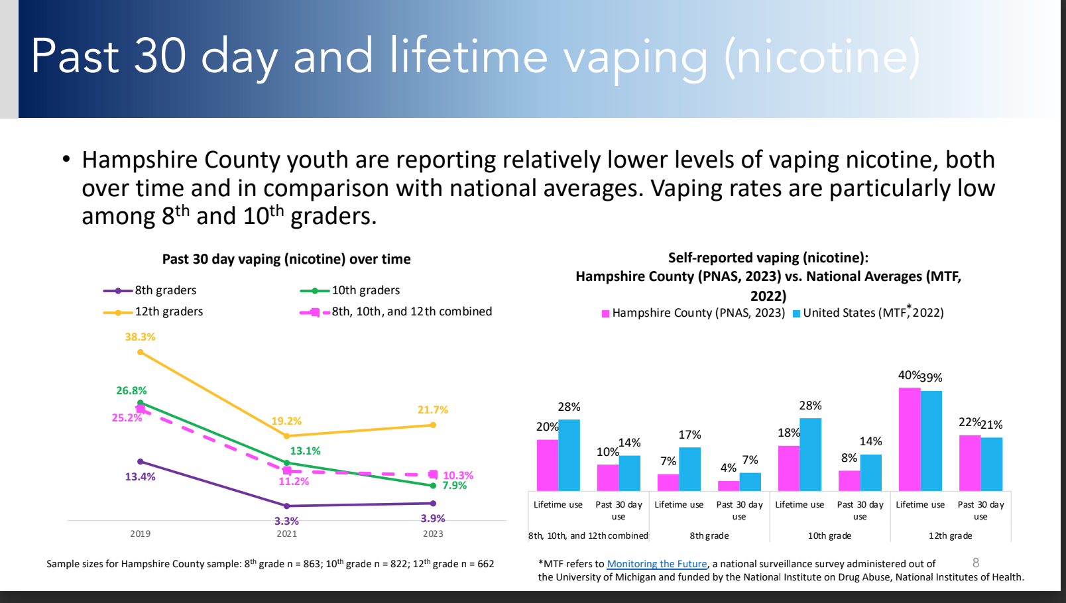

Slide 41
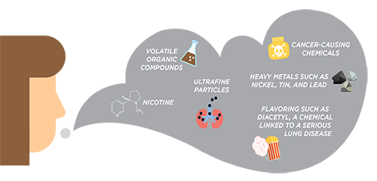
Reality: There are Risks of Vaping
CDC; https://www.cdc.gov/tobacco/basic_information/e-cigarettes/about-e-cigarettes.html

Slide 42
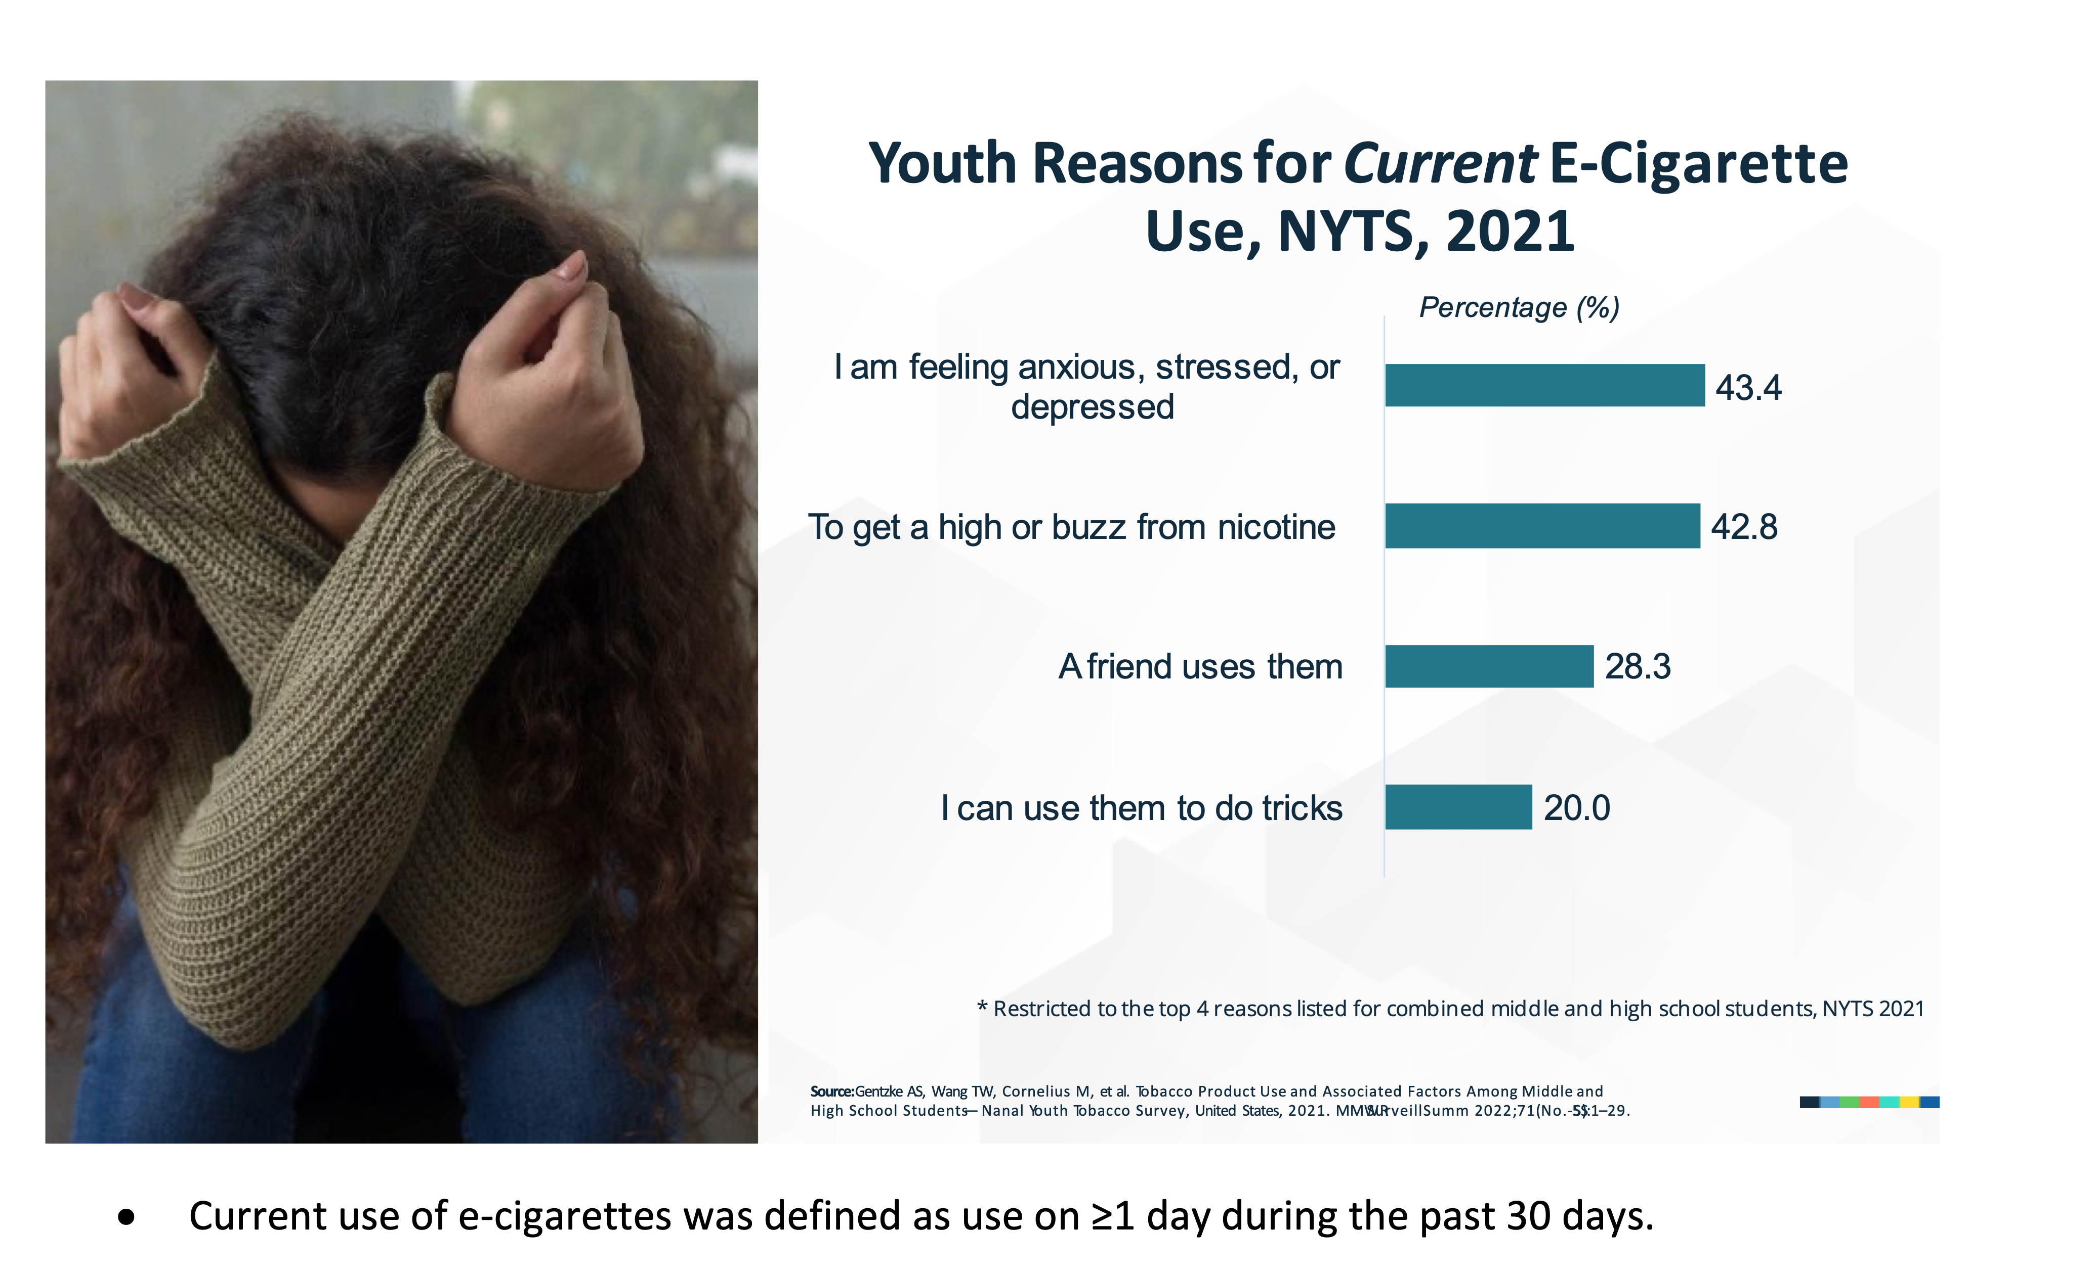

Slide 43
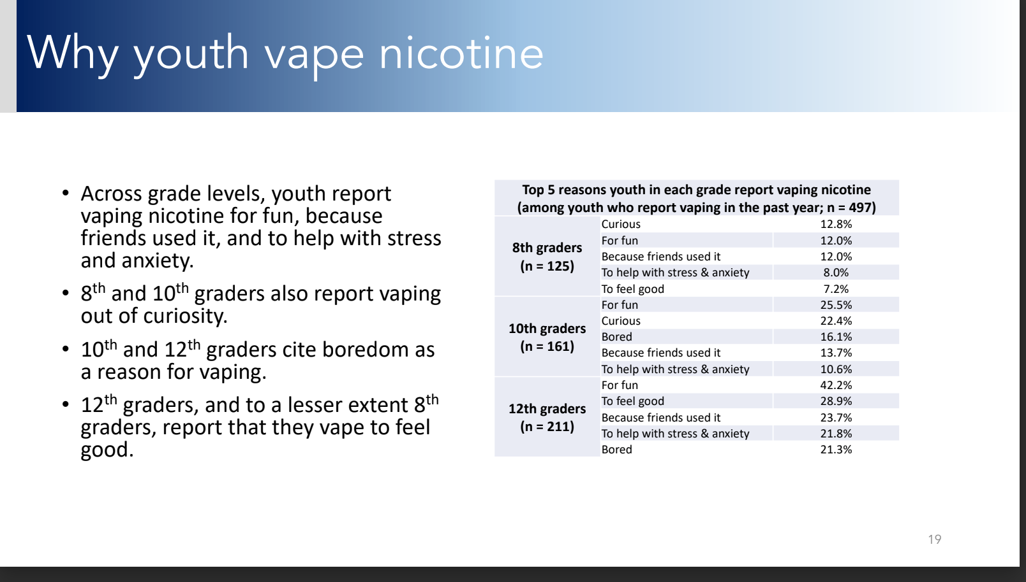

Slide 44
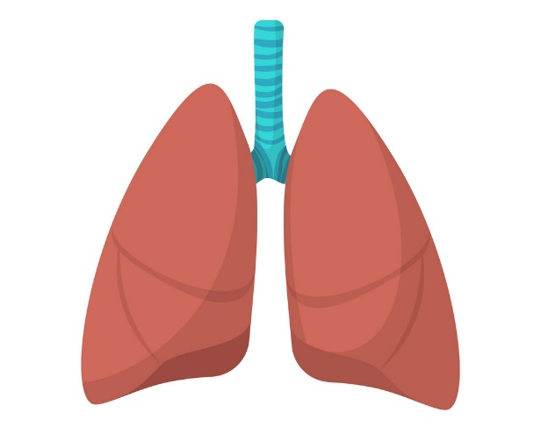

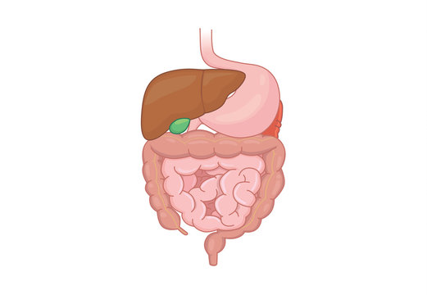
E-Cigarette/Vaping Associated Lung Injury (EVALI)
97% respiratory
symptoms:
Shortness of breath
Chest pain
Cough
Coughing up blood
100% generalized symptoms:
Subjective fever
Chills
Weight loss
Fatigue
77% GI symptoms:
Nausea
Vomiting
Diarrhea
Abdominal Pain
Layden et al., Pulmonary illness related to e-cigarette use in Illinois and Wisconsin – Final report. N Engl J Med. 2020.
Notes:
One of the other most publicized consequences of marijuana use and vaping is EVALI, or e-cigarette or vaping associated lung injury. The CDC initially reported cases in Spring of 2019, and as of February 2020 there were 2807 cases reported with 68 deaths. We now know that EVALI can present as a much broader spectrum of symptoms and pulmonary severity.
Confirmed case = history of vaping in 90d prior + pulmonary infiltrates or opacities on CXR or ground-glass opacities on chest CT + absence pulmonary infection on workup + no alternative plausible diagnosis
Probable cause = history vaping + imaging findings + no evidence of alternative diagnosis + POSITIVE test for pulmonary infection that is NOT thought to be only cause of symptoms

Slide 45

Alcohol
Notes:
Alcohol is a central nervous system depressant. It acts at many sites, including the reticular formation, spinal cord, cerebellum and cerebral cortex, and on many neurotransmitter systems. Alcohol is a very small molecule and is soluble in "lipid" and water solutions. Because of these properties, alcohol gets into the bloodstream very easily and also crosses the blood brain barrier. Some of the neurochemical effects of alcohol are:
Increased turnover of norepinephrine and dopamine
Decreased transmission in acetylcholine systems
Increased transmission in GABA systems
Increased production of beta-endorphin in the hypothalamus
They use alcohol differently
e.g. adolescents may drink to fulfill their developmental drive to engage in risk-taking behavior
e.g. binge drinking is more common amongst adolescents, due in part, as we’ll discuss shortly, to adolescents’ reduced sensitivity to the motor impairing effects of alcohol such as lack of coordination or drowsiness.
b. They face different long term risks
e.g. because the brain does not fully develop until age 25, substance use negatively impacts the growth of still-developing brain structures in adolescents, leading to permanent changes in brain structure and function that can cause cognitive or learning problems and predispose persons to substance use disorders
c. They have greater use of other psycho-active substances
Because alcohol can cross the blood brain barrier, it affects multiple areas and functions of the brain:
1. The brain stem (made up of the Pons, Medulla, and Midbrain), regulates breathing, heart rate, and consciousness
2. Frontal Lobe– involved in movement, problem-solving, concentrating, thinking, mood, behavior, and personality
3. Temporal – involved in hearing, language, and memory
4. Parietal – involved in sensation awareness, language, perception, attention, and body awareness
5. Occipital – involved in vision and perception
6. Cerebellum – involved in posture, balance, and coordination of movement

Slide 46
  90%
of all alcohol consumed by underage drinkers occurs in the context of a binge.
© Boston Children’s Hospital, 2020. All Rights Reserved.
Source: https://www.niaaa.nih.gov/publications/brochures-and-fact-sheets/underage-drinking
Notes:
Because alcohol is a CNS depressant, it causes a relaxing effect in small doses.
As we’ve discussed, adolescents lack the impulse control that most adults have, meaning that the vast majority of alcohol consumed by adolescents occurs in the context of a binge.
Alcohol also effects adolescents and adults differently. To show this, Researchers performed a test with rats to see how alcohol effected adolescents and adults differently.
They put adolescent and adult rats in an open testing area and tracked their movement. Then, the rats were given alcohol and put back in the open testing area. Adolescent rats’ movement decreased by less than half (47%) whereas adult rats’ movement decreased by more than three-quarters (78%).
This demonstrates that adolescent rats are less sensitive to the motor-impairing effects of alcohol. Given equivalent doses of alcohol, adults become sedated while adolescents remain active, even though they are impaired.
For the adult rats, it took them longer to find the platform, and the speed of their swimming movements decreased.
The adolescent rats also took longer to reach the platform but the speed at which they swam stayed the same.
Adolescents are less sensitive to the motor impairing effects of alcohol, yet the cognitive effects are the same.

Slide 47
Correlates of Substance Use
During Adolescence
Injuries (intentional/unintentional) | Arrests, incarceration
Emergency room visits | Sexual assaults
School failure | Unprotected sex
Violence | STI’s, including HIV
Source: DuRant R et al. J Adolesc Health 1997;21(5):303-308.; DuRant RH et al. Arch Pediatr Adolesc Med. 1999;153(1):21-26.; Hingson RW et. al. Am J Public Health 1990;80:1-5.; Jessor R. J Adolesc Health 1991;12:597-605.
© Boston Children’s Hospital, 2020. All Rights Reserved.
Notes:
Alcohol and other drug use is correlated with significant morbidity during adolescence.
Schram - Misuse of Prescription Meds
47

Slide 48
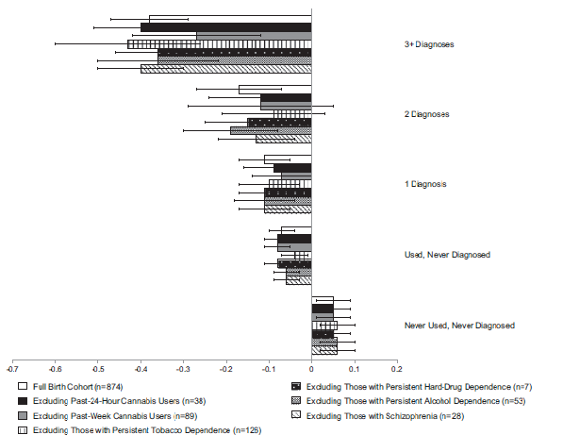
MJ dependent 3+ yrs
MJ dependent 2 yrs
Average IQ change
Never used: 99.8 to 100.6
MJ dependent 3+ yrs: 99.7 to 93.9
MJ dependent 1 yr
Used, never diagnosed
Source: Meier et al. (2012). Persistent cannabis users show neuropsychological decline from childhood to midlife. P Nat Acad Sci 109(40):E2657–E2664.
Never used
© Boston Children’s Hospital, 2020. All Rights Reserved.
Notes:
When their adult IQ was tested at 38 years old, the heaviest and most persistent adolescent-onset marijuana users in the study had experienced an average decline of eight IQ points from childhood to adulthood.
Non-users had on average increased their IQ by around one point.
And even after setting aside the heaviest users, a decline of a few IQ points from their childhood value was still seen in less heavy users who had started in their teens.
What's more, the drop in mental function seemed irreversible even after persons had quit cannabis.

Slide 49
Important Points
The adolescent brain is not fully developed
The “reward pathway” is highly sensitive during adolescence increasing susceptibility to developing addiction
Substance use during adolescence can change the developing brain (e.g. neural pathways) increasing risk for learning, memory and mental health problems

Slide 50
Questions?

